Slide 1
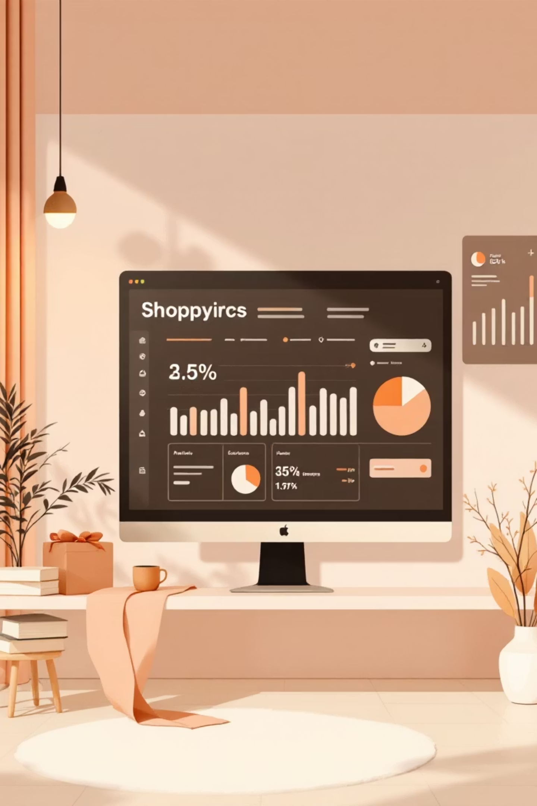
Customer Shopping Behavior Analysis
Uncovering insights from 3,900 purchases to drive strategic business decisions

Slide 2
Dataset Overview
3,900
18
50
25
Total Purchases
Data Points
Locations
Products
Transactions analyzed across all categories
Features tracking customer behavior
Geographic distribution of customers
Unique items purchased
Customer Demographics
Purchase Details
Shopping Behavior
Age, Gender, Location
Item, Category, Amount
Discounts & Promo Codes
Subscription Status
Season, Size, Color
Review Ratings, Shipping

Slide 3




Our Analytics Tech Stack
Python
Data cleaning, feature engineering, pandas analysis
PostgreSQL
Structured queries, business transactions, segmentation
Power BI
Interactive dashboards, visual insights, real-time reporting

Slide 4
Python: Data Preparation
01
02
03
Data Loading & Exploration
Missing Data Handling
Feature Engineering
Imported dataset, checked structure with df.info() and summary statistics
Imputed 37 missing Review Ratings using median by category
Created age_group bins and purchase_frequency_days columns
04
05
Data Consistency
Database Integration
Standardized columns to snake_case, dropped redundant promo_code_used
Connected to PostgreSQL and loaded cleaned DataFrame

Slide 5
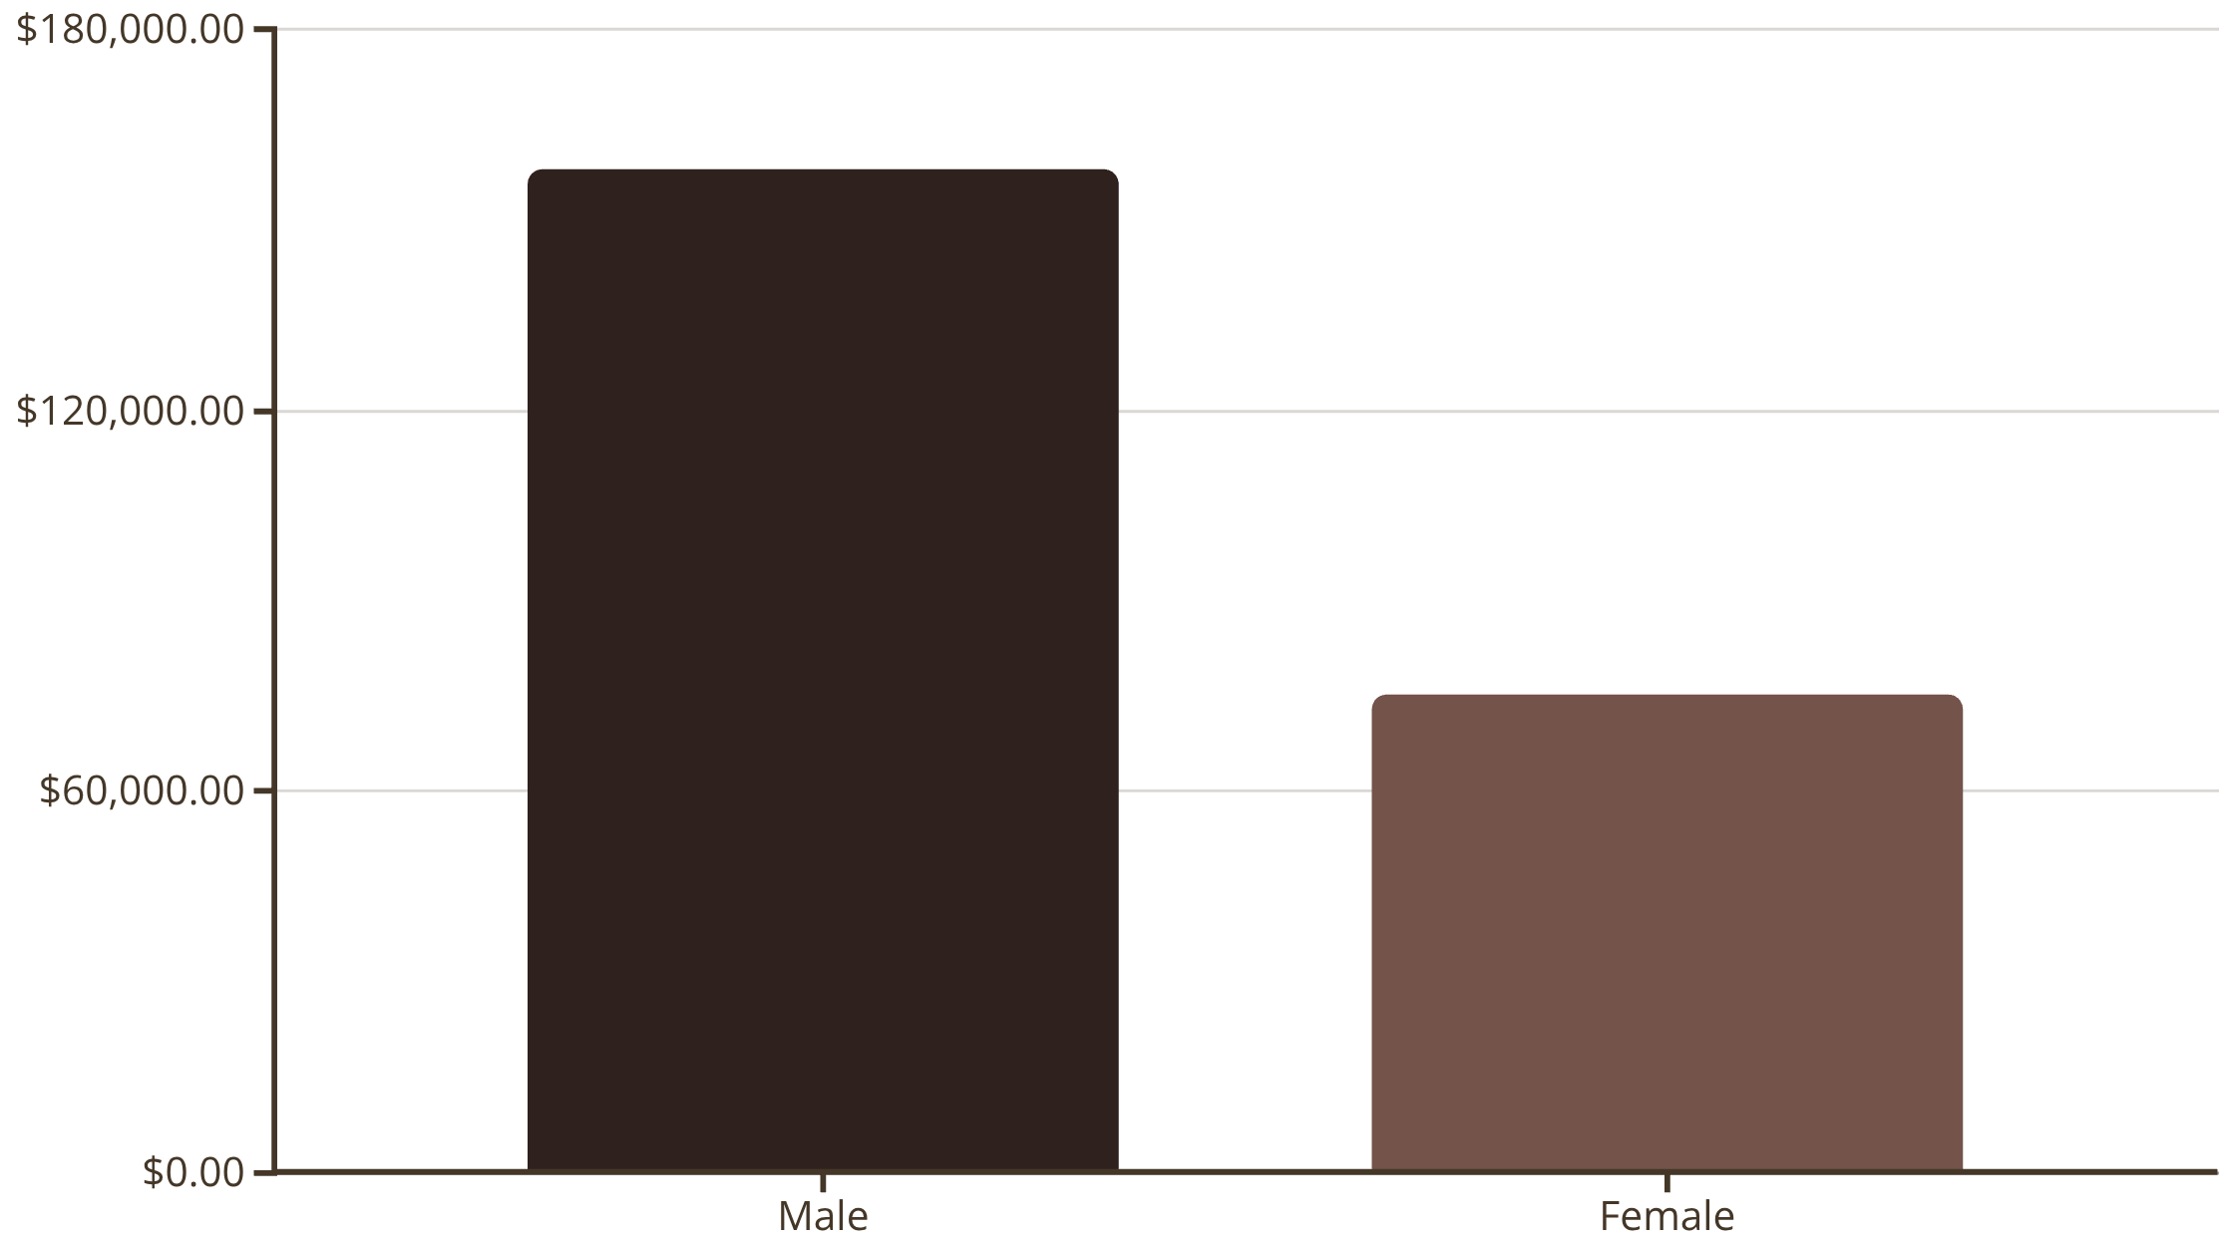
Revenue Insights
Gender Distribution
High-Spending Discount Users
Male customers generate 68% of total revenue despite representing 68% of customer base
839 customers used discounts but still spent above $60 average

Slide 6
Top-Rated Products
Sandals
Boots
Hat
Gloves
⭐ 3.84 rating
⭐ 3.82 rating
⭐ 3.80 rating
⭐ 3.86 rating
Skirt
⭐ 3.78 rating

Slide 7
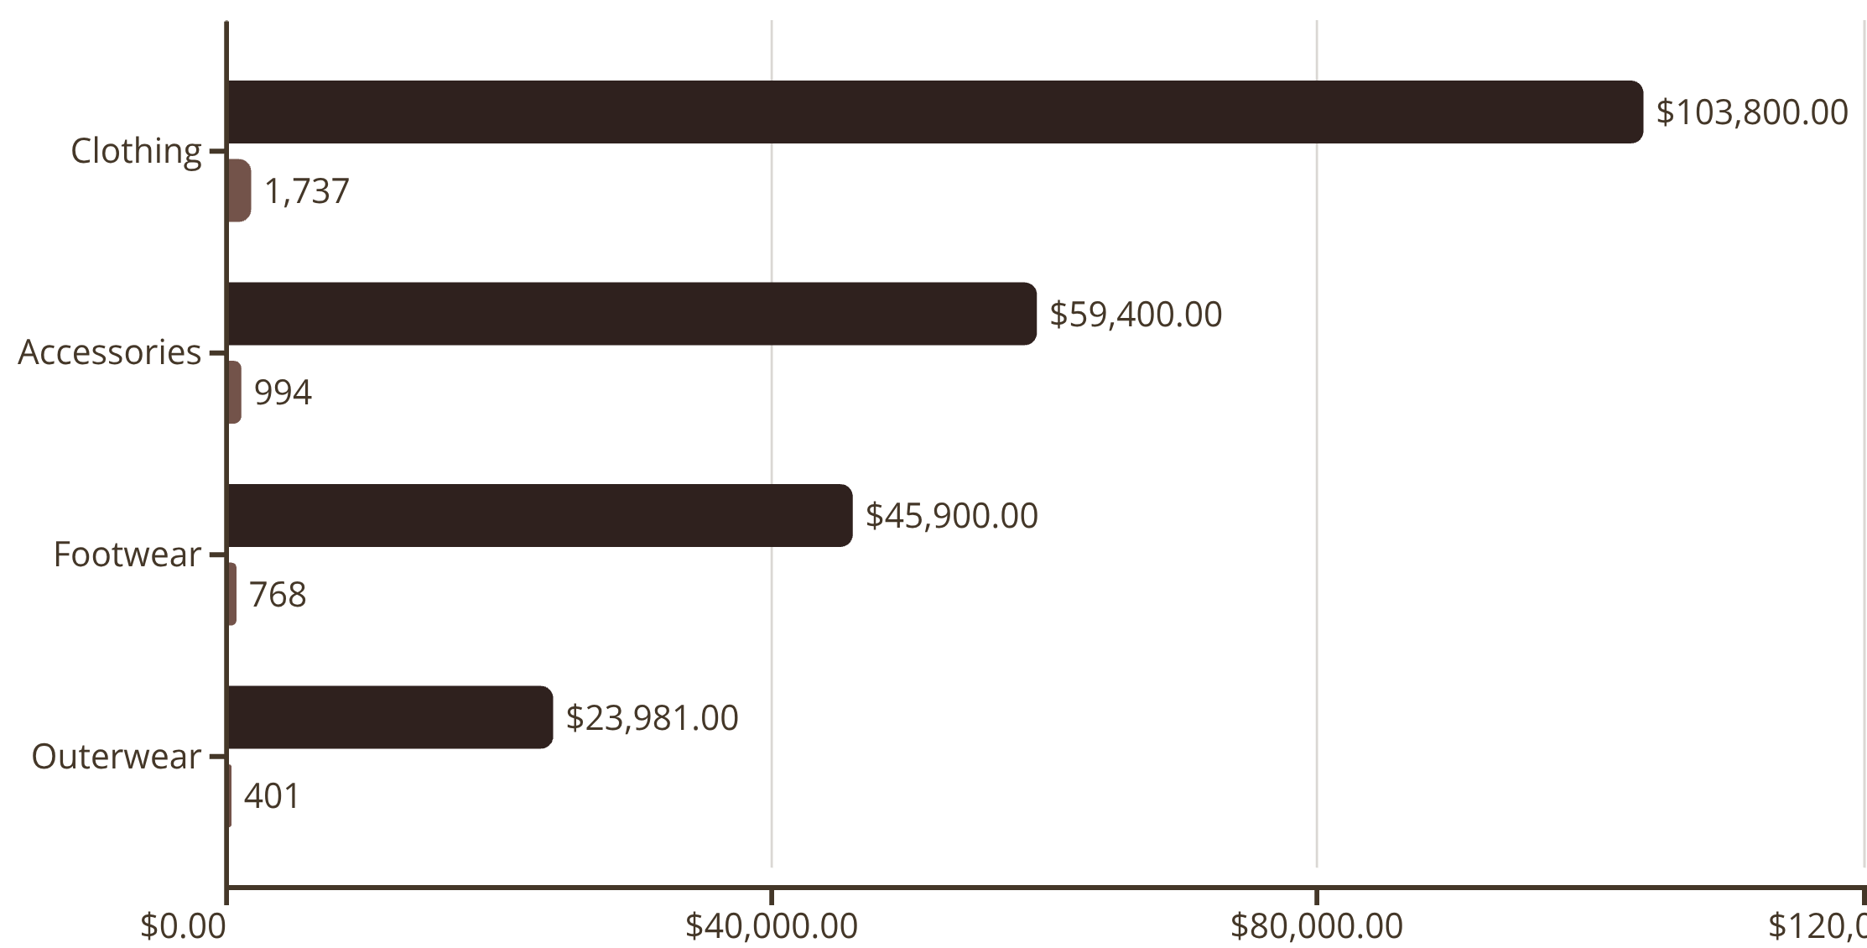
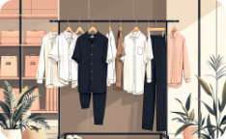

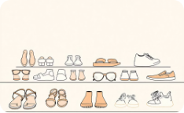

Category Performance
Revenue
Sales Volume
Clothing
Accessories
Footwear
Outerwear
Blouse, Pants, Shirt lead sales
Jewelry, Sunglasses, Belt top performers
Sandals, Shoes, Sneakers most popular
Jacket, Coat drive category

Slide 8
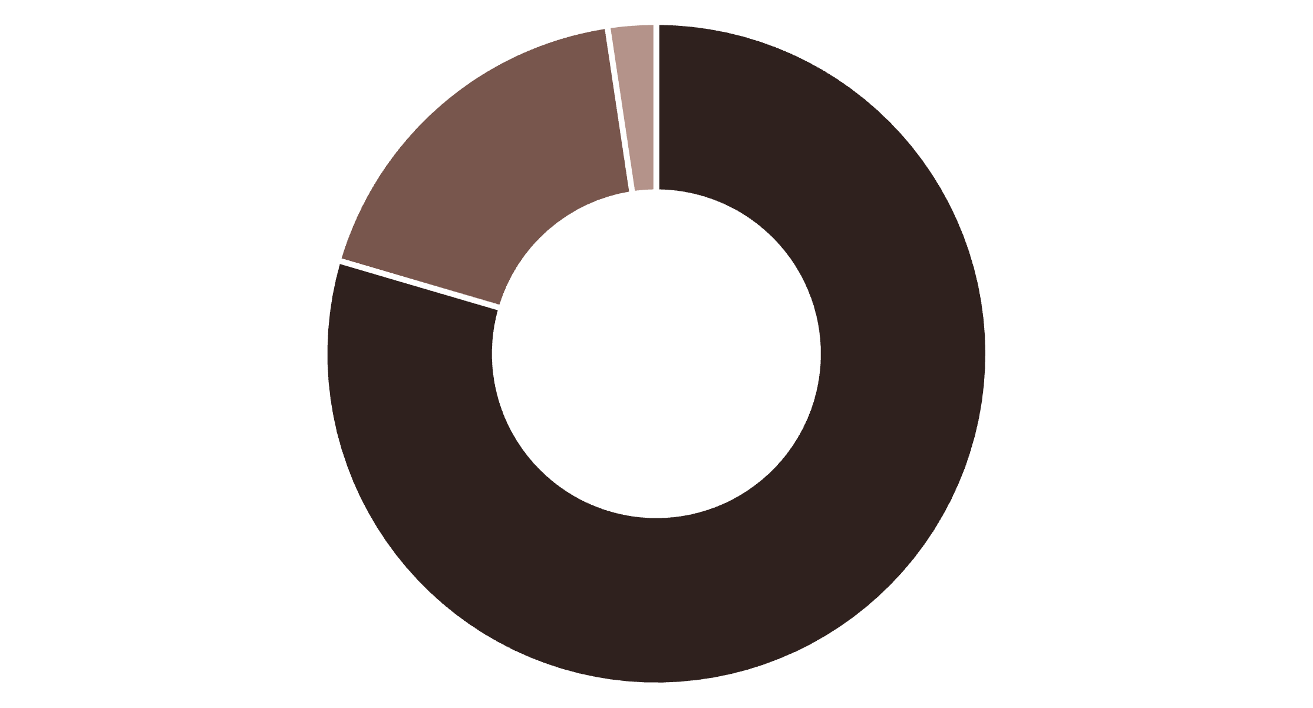
Customer Segmentation
Loyal
Returning
New
Subscription Analysis
Subscription vs Non-Subscribers
958 repeat buyers (>5 purchases) have subscriptions
Subscribers: 1,053 customers, $59.49 avg spend
2,518 repeat buyers without subscriptions represent opportunity
Non-subscribers: 2,847 customers, $59.87 avg spend
Total revenue: $233,081

Slide 9
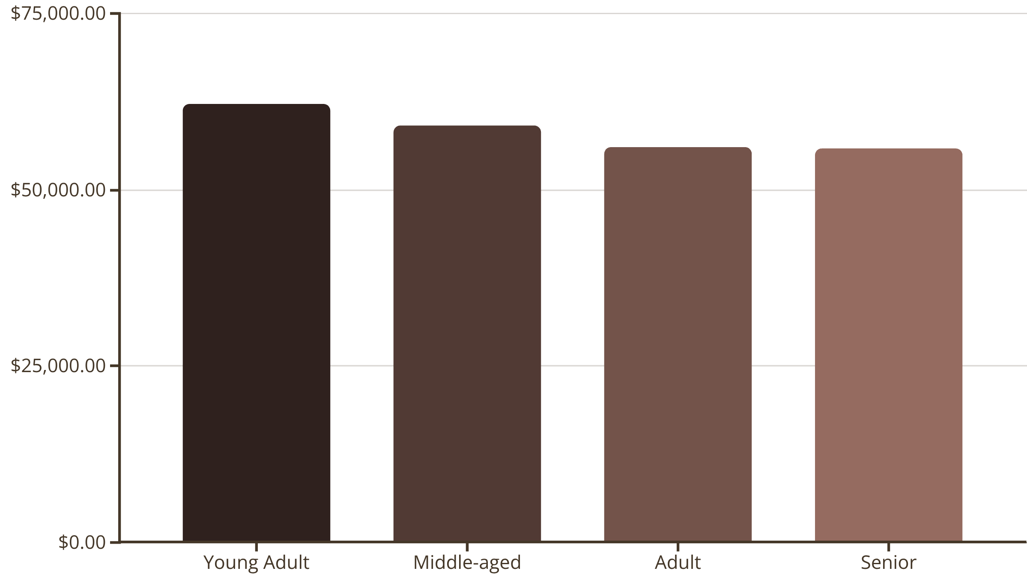
Age Group & Shipping Insights
Express Shipping
Standard Shipping
Discount-Dependent
$60.48 average purchase
$58.46 average purchase
Hat (50%), Sneakers (49.7%), Coat (49.1%)

Slide 10
Strategic Recommendations
1
Boost Subscriptions
Promote exclusive benefits to convert 2,518 repeat buyers without subscriptions
2
Customer Loyalty Programs
Reward returning customers to accelerate movement into loyal segment
3
Review Discount Policy
Balance sales boosts with margin control for high-discount products
4
Product Positioning
Highlight top-rated items (Gloves, Sandals, Boots) in marketing campaigns
5
Targeted Marketing
Focus on Young Adults and express-shipping users for maximum ROI

